Slide 1
Natural Disasters Intensity Analysis And Classification Using AI

Slide 2
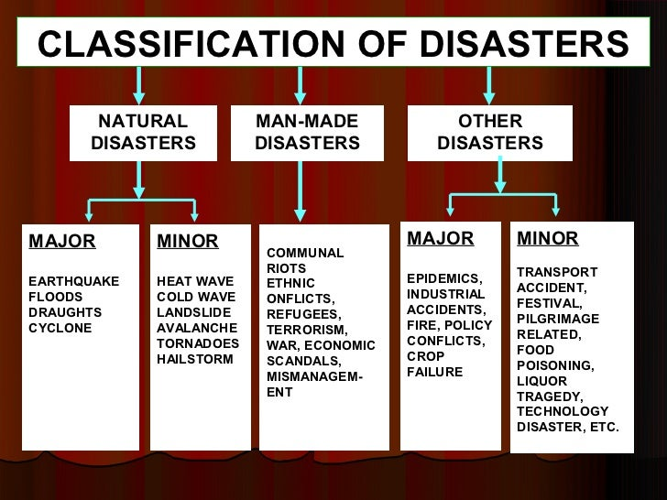
Introduction
Natural Disasters Intensity Analysis and Classification using AI.
AI-based technologies are revolutionizing disaster management.
AI can accurately analyze and classify the intensity of natural disasters.
1

Slide 3
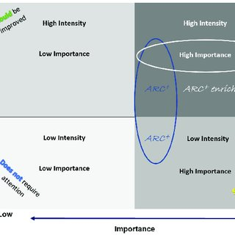
Importance of Intensity Analysis
Intensity analysis helps predict the impact and severity of natural disasters.
Enables effective evacuation and emergency response planning.
Assists in allocating resources and prioritizing relief efforts.
2

Slide 4
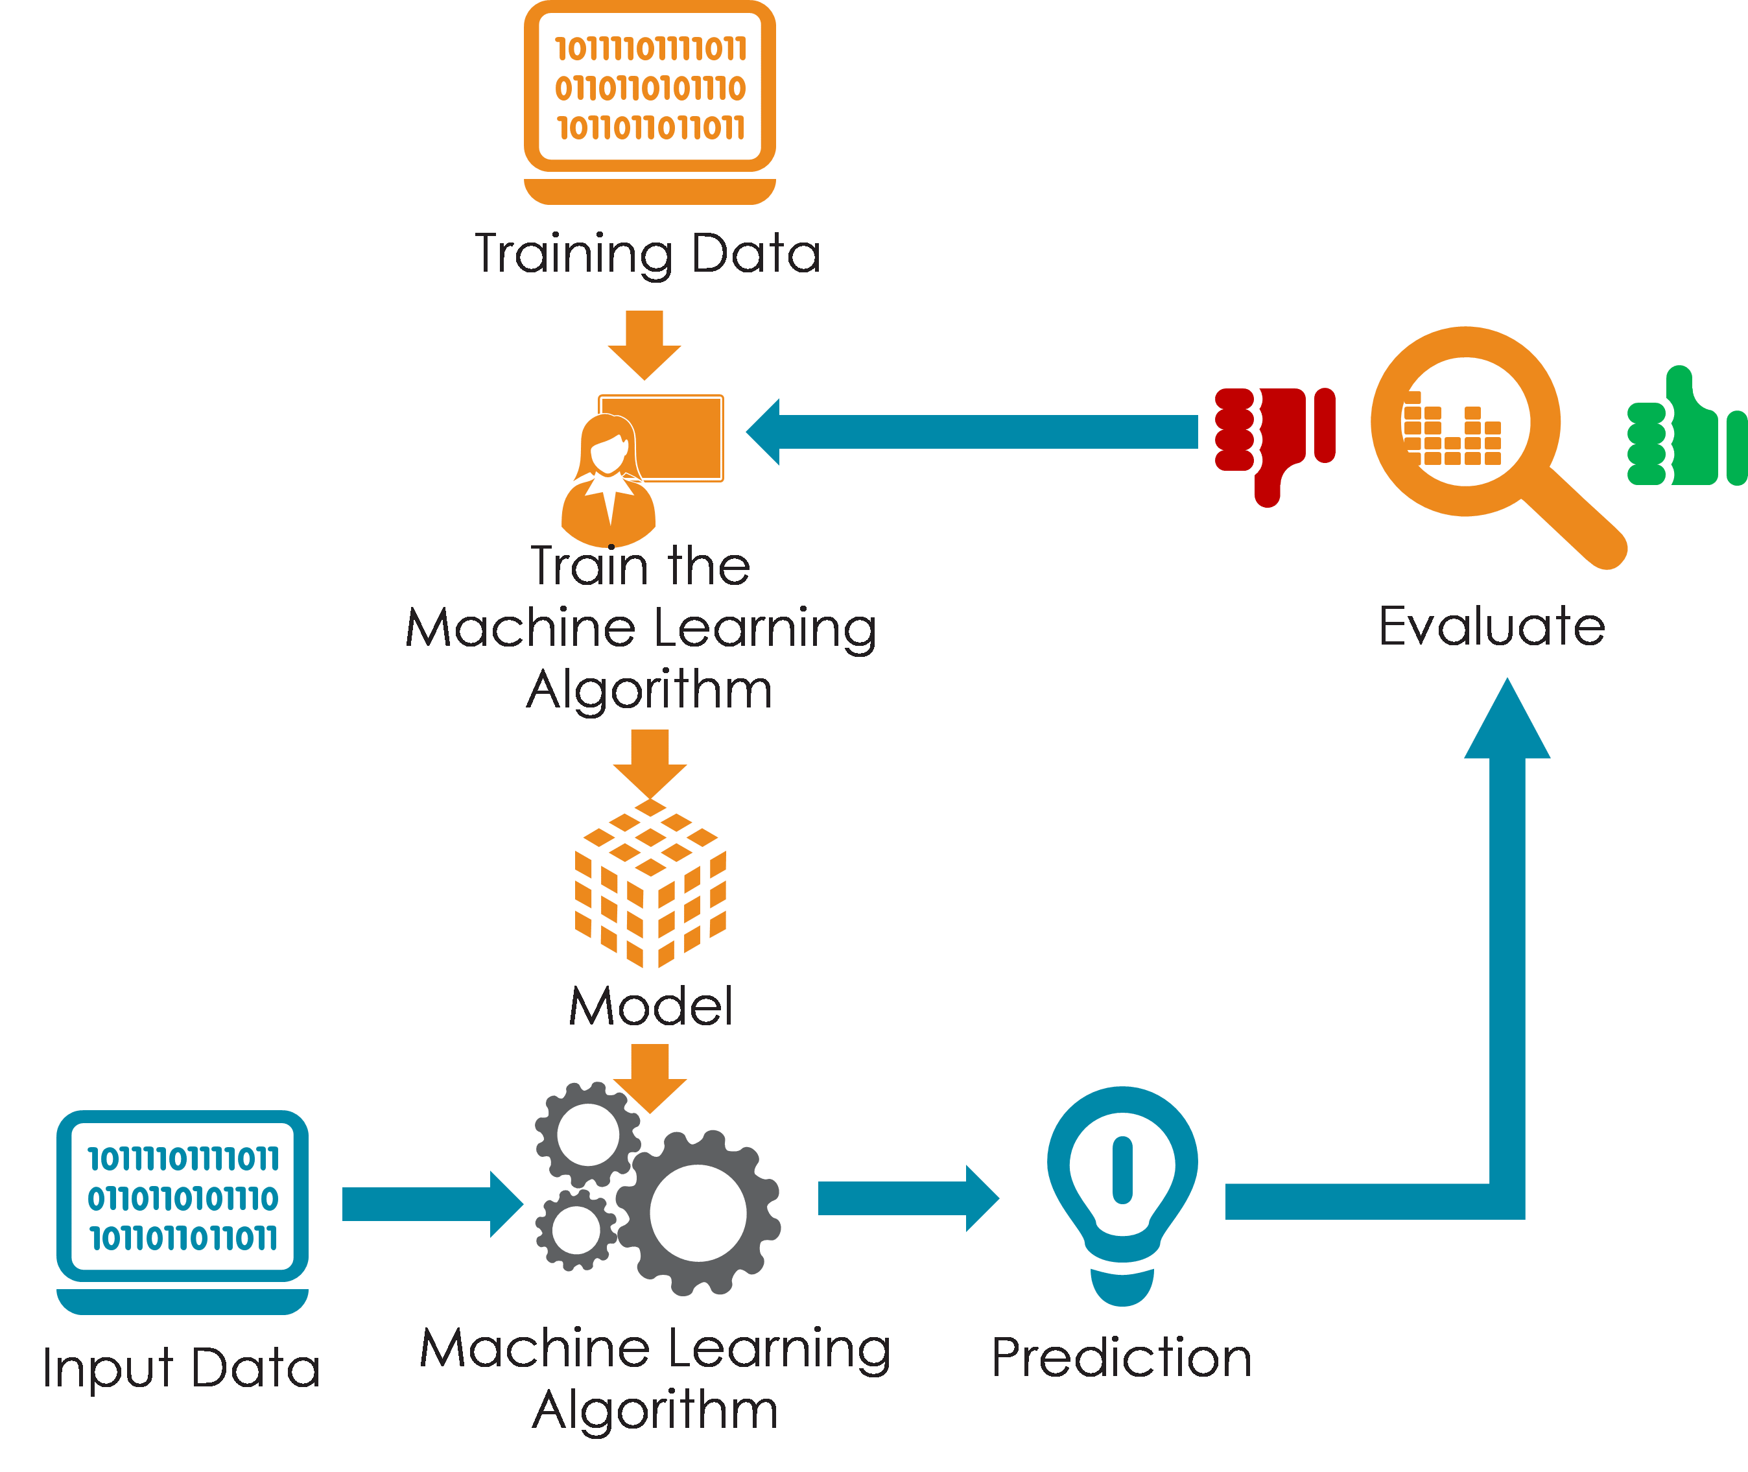
AI Techniques for Intensity Analysis
Machine Learning algorithms can analyze historical data to predict disaster intensity.
Deep Learning models can process large amounts of data to identify patterns and trends.
Natural Language Processing can analyze textual information for early detection of disaster events.
3

Slide 5
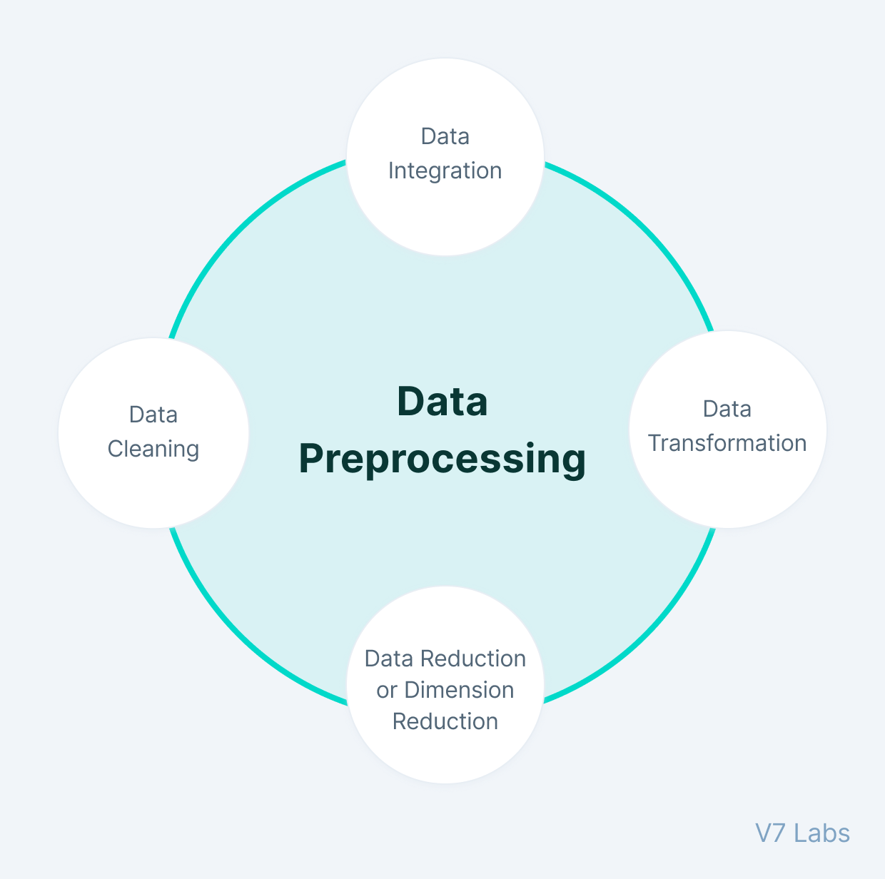
Data Collection and Preprocessing
Gathering data from various sources like satellite imagery, weather stations, and social media.
Preprocessing involves cleaning, normalizing, and integrating data for analysis.
Data augmentation techniques enhance the quality and quantity of training data.
4

Slide 6
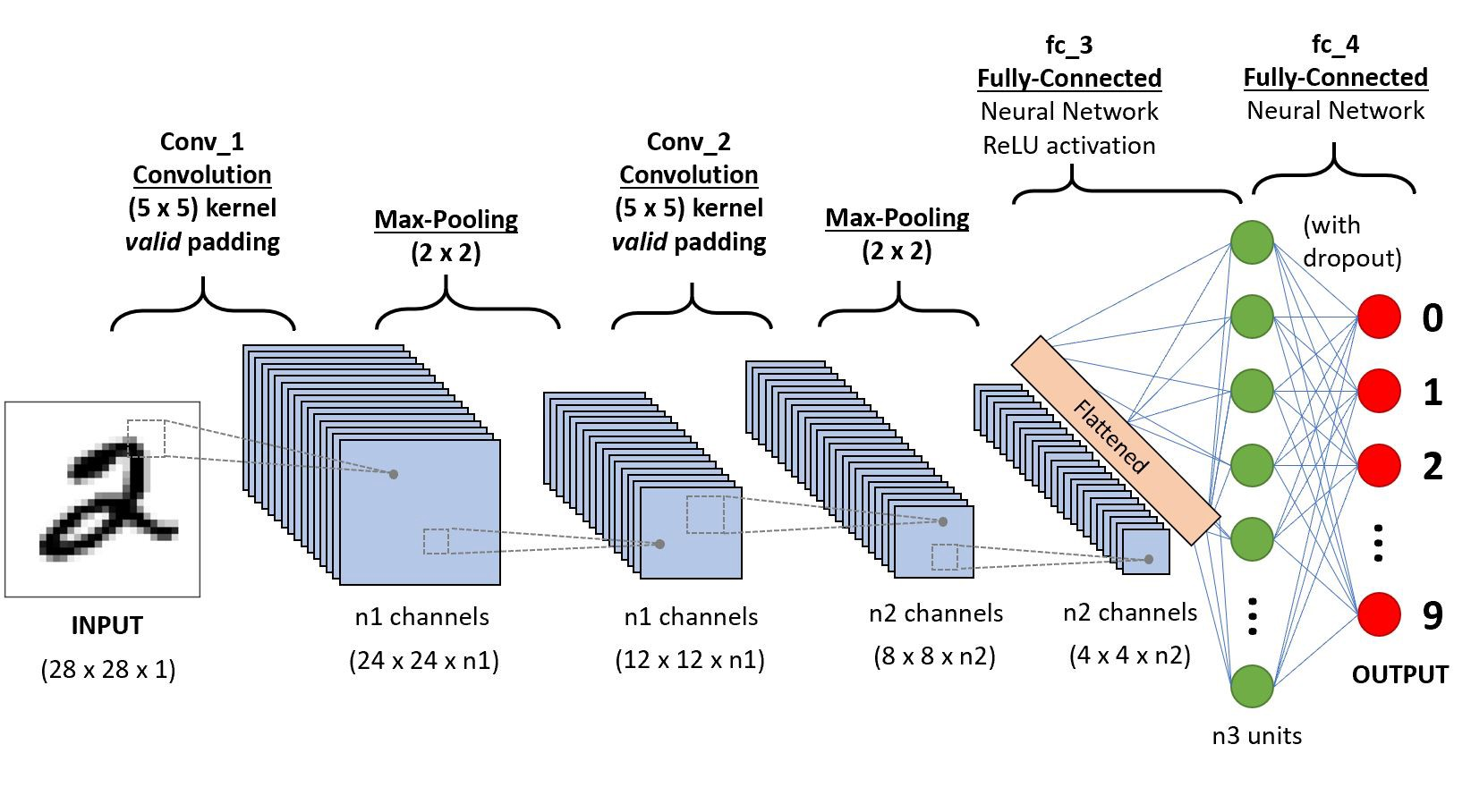
AI Models for Intensity Analysis
Convolutional Neural Networks (CNNs) for image-based analysis.
Recurrent Neural Networks (RNNs) for time-series data analysis.
Ensemble models combining multiple AI techniques for improved accuracy.
5

Slide 7
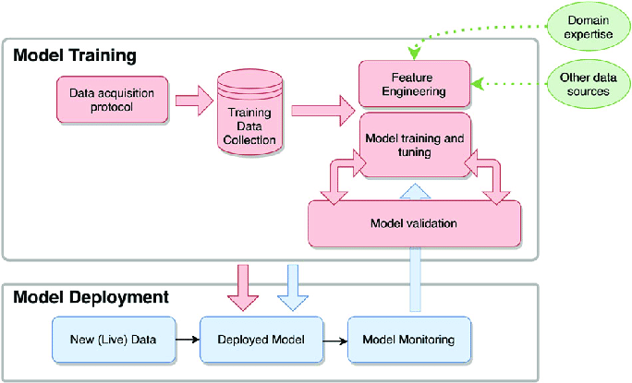
Training and Validation
Training AI models using labeled data to learn patterns and make predictions.
Validation of models using separate datasets to evaluate performance.
Iterative training and validation process to optimize model accuracy.
6

Slide 8
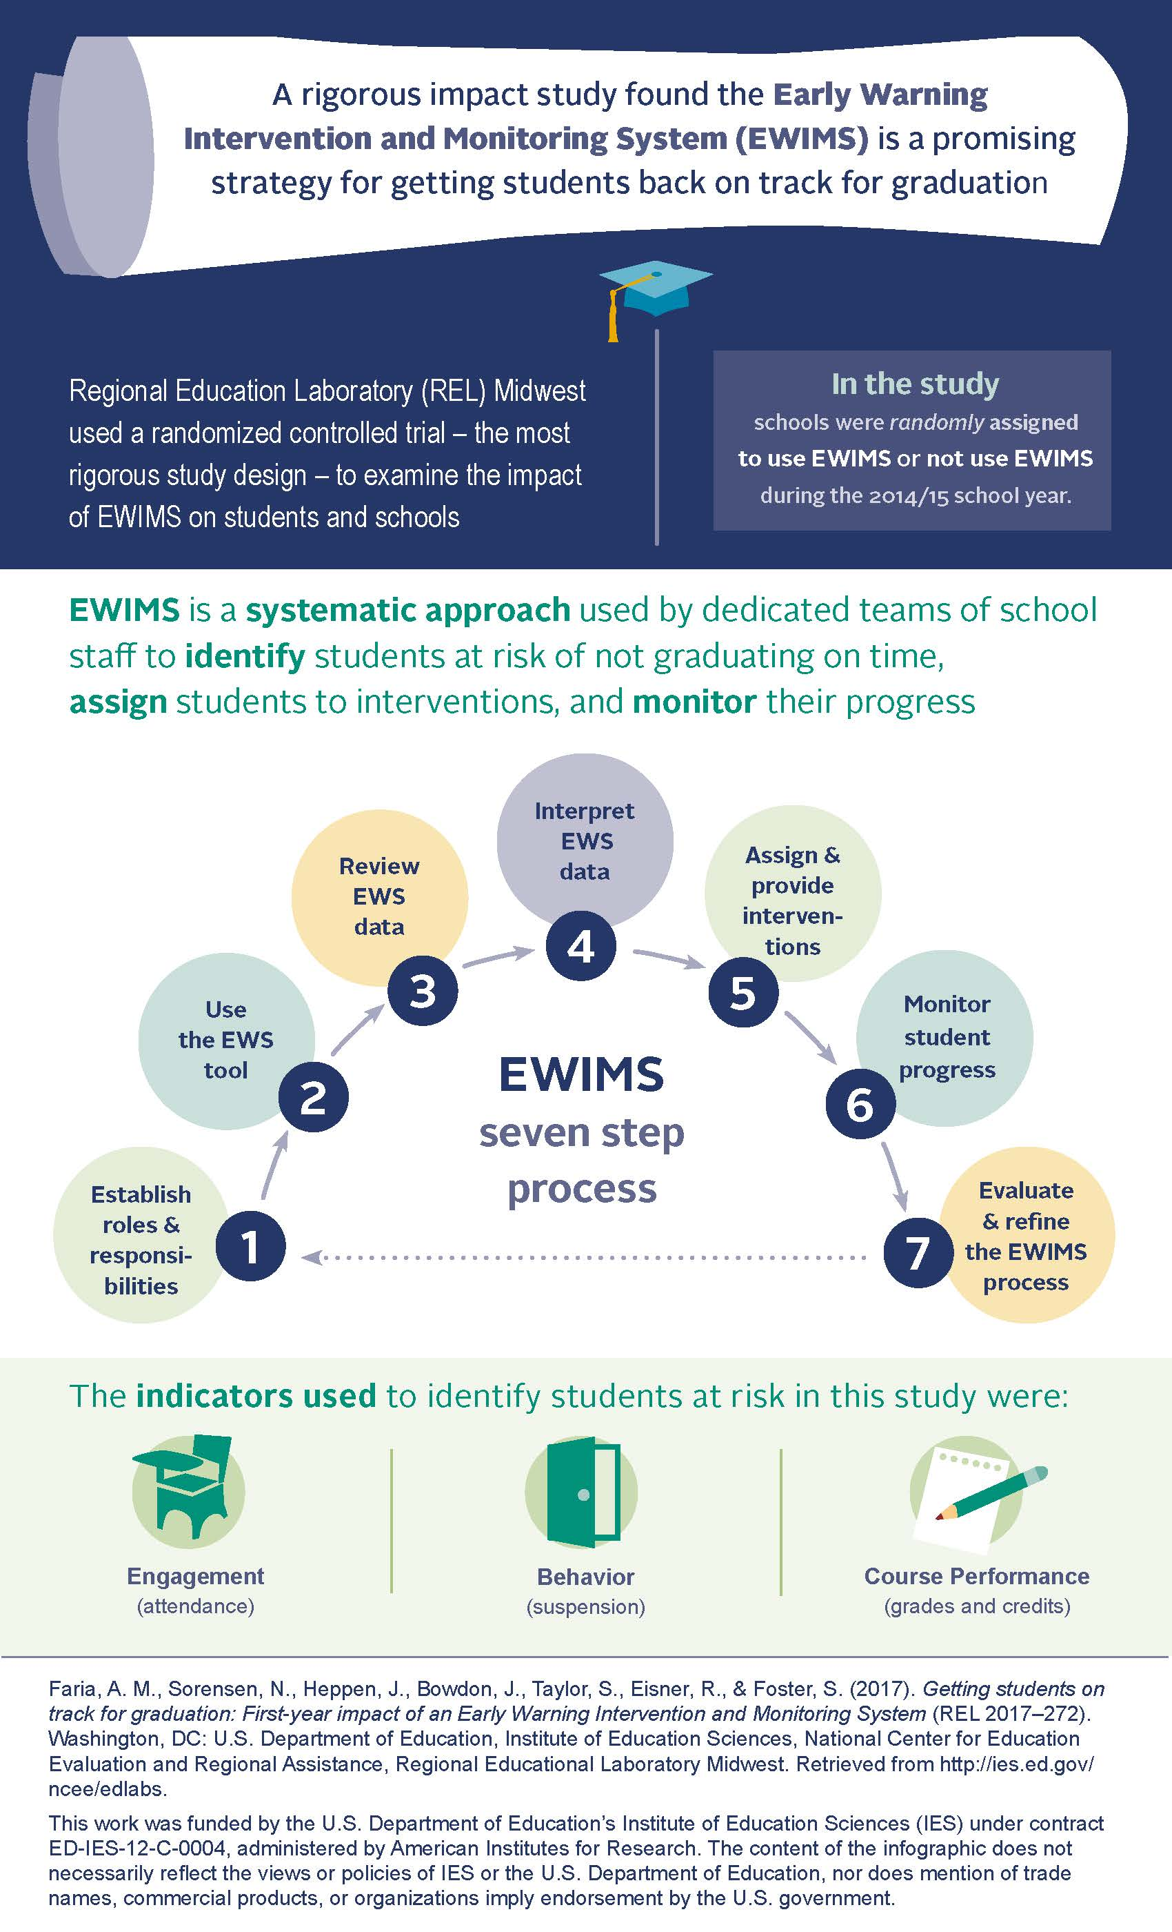
Real-time Monitoring and Early Warning Systems
AI algorithms continuously process incoming data for real-time monitoring.
Early warning systems leverage AI to provide timely alerts and notifications.
Integration with existing disaster management systems for seamless operations.
7

Slide 9
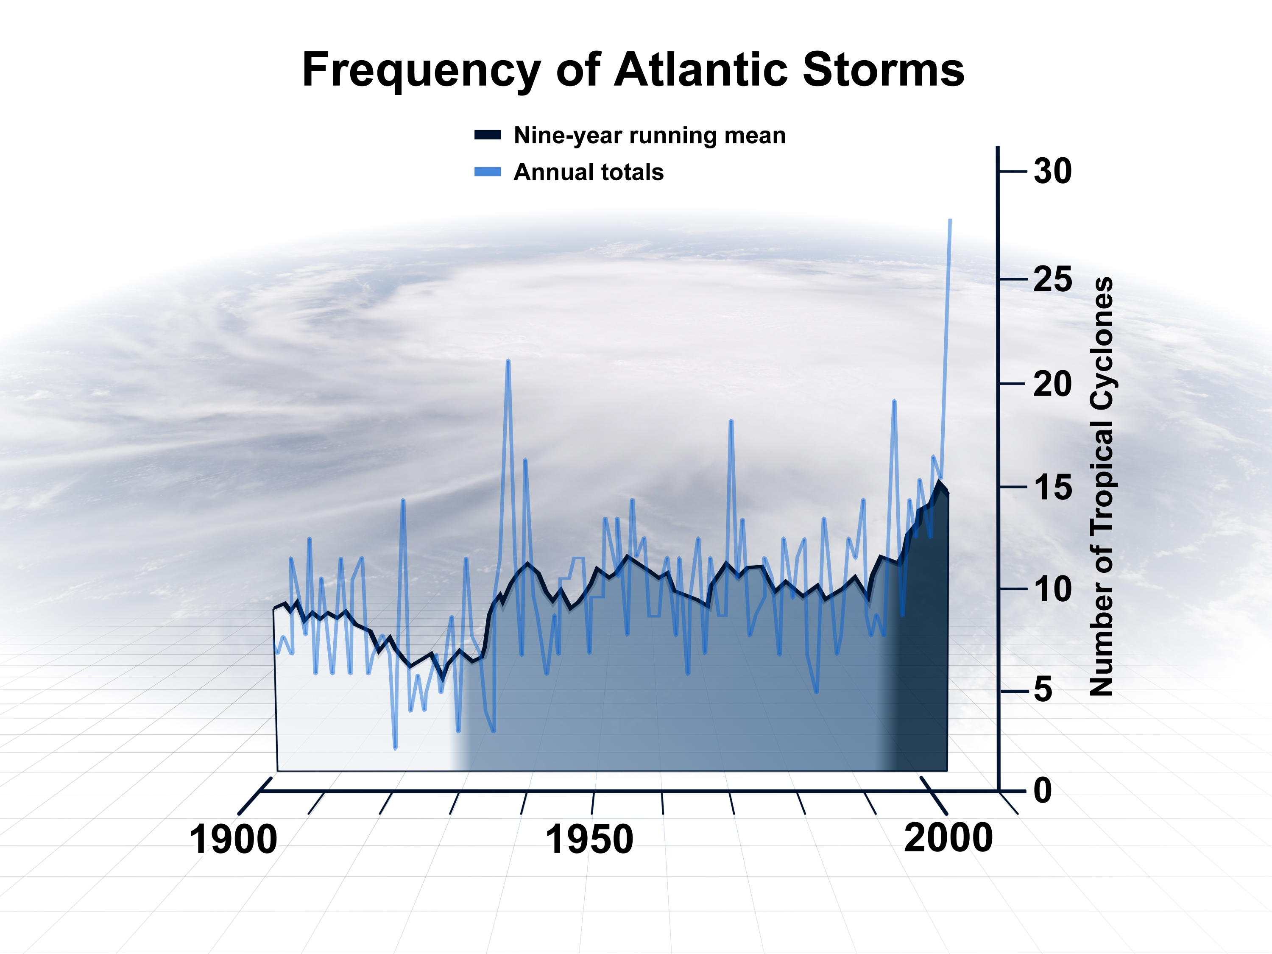
Case Study - Hurricane Intensity Analysis
Applying AI to analyze satellite imagery and atmospheric data for hurricane intensity prediction.
Improved accuracy in forecasting hurricane strength and potential impact.
Assisting meteorologists and emergency management agencies in decision-making.
8

Slide 10
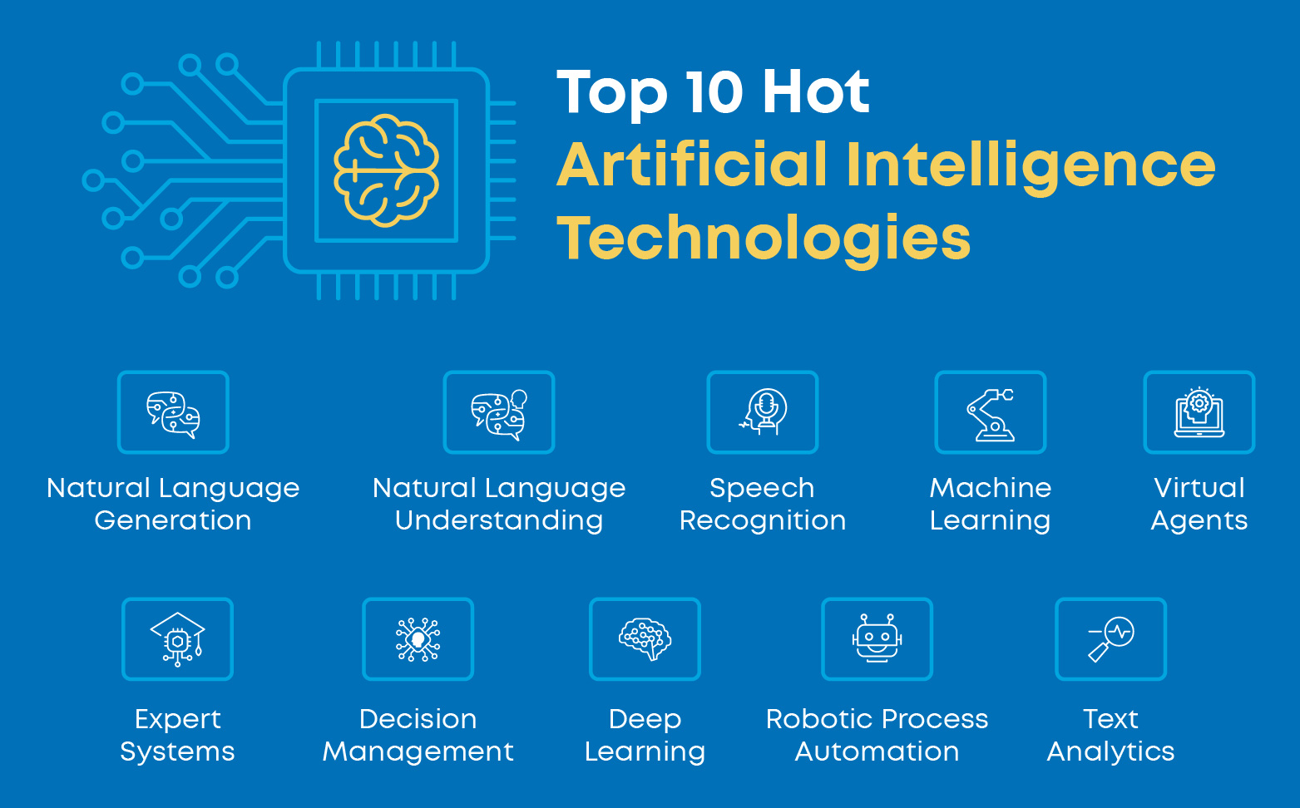
Future Directions and Challenges
Advancements in AI technologies will enhance the accuracy and speed of intensity analysis.
Integration with Internet of Things (IoT) devices for real-time data collection.
Addressing challenges like data privacy, interpretability, and model bias.
9

Slide 11
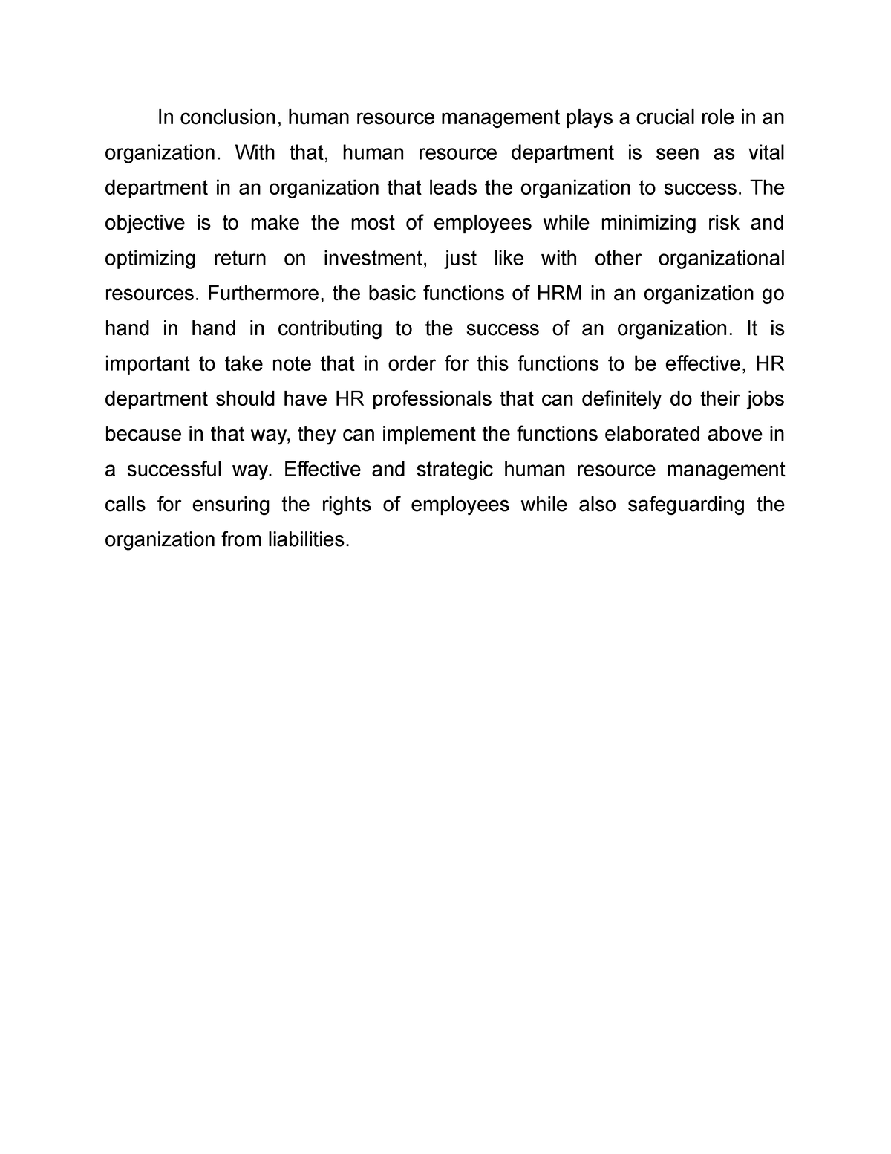
Conclusion
AI plays a crucial role in analyzing and classifying natural disasters' intensity.
Improved accuracy leads to better disaster management and mitigating the impact.
Continued research and development in AI can revolutionize the field of disaster management.
10

